Slide 1
The Sentinel Firewall
Safe-product substitution as a high-return intervention to reduce lead exposure at critical ages David I. Levine

Slide 2
Talk Roadmap
Lead exposure: why economists should care
Why informal consumer products create a policy problem
The Sentinel Firewall idea
Economic model and main assumptions
Results and uncertainty
What the tool lets ministries, NGOs and researchers do locally

Slide 3
Why Lead Matters
Lead is a neurotoxin with no known safe threshold for children.
The biggest losses are often invisible: cognition, learning, behaviour, adult productivity.
Exposure during pregnancy and early childhood is especially damaging because the brain is developing rapidly.

Slide 4
Adult cardiovascular disease is also important, but this talk focuses mainly on child cognition and earnings.

Slide 5
The Post-Gasoline Lead Problem
Rich countries largely reduced lead through gasoline, paint and formal-sector regulation.
Many LMIC exposures now come from harder-to-regulate sources:
artisanal aluminium cookware made from mixed scrap
traditional cosmetics such as kohl, kajal or surma
lead-contaminated ceramics, cups, bowls and utensils
These products are ordinary household goods, not obvious “industrial pollution” to consumers.

Slide 6
Why This Is an Economics Problem
Households often cannot observe lead content or delayed cognitive harm.
Informal producers may not internalise downstream health and productivity losses.
Regulators may not know which products or supply chains are dangerous.
The key market failure is not only pollution; it is hidden product quality plus delayed human-capital damage.

Slide 7
Policy Gap
First-best policy: remove lead from products and supply chains.
But enforcement and industrial upgrading can be slow.
Pregnant women and infants are exposed now.
Question: can health systems create a temporary consumer firewall while regulation catches up?

Slide 8
Sentinel Firewall
Use sentinel screening to identify high-risk districts or catchments.
Deploy modular safe-product packages through existing maternal and child health contacts.
Use uptake, surrendered products and biomonitoring to inform enforcement.
This is harm reduction, not a substitute for eliminating lead from production.

Slide 9
Modelled Packages
Kitchen Package:
ANC voucher for a lead-safe cooking pot
ANC calcium supplements
safe child feeding utensils at immunisation
Kohl Package:
safe maternal kohl through ANC
safe infant kohl through facility delivery or early-immunisation catch-up

Slide 10
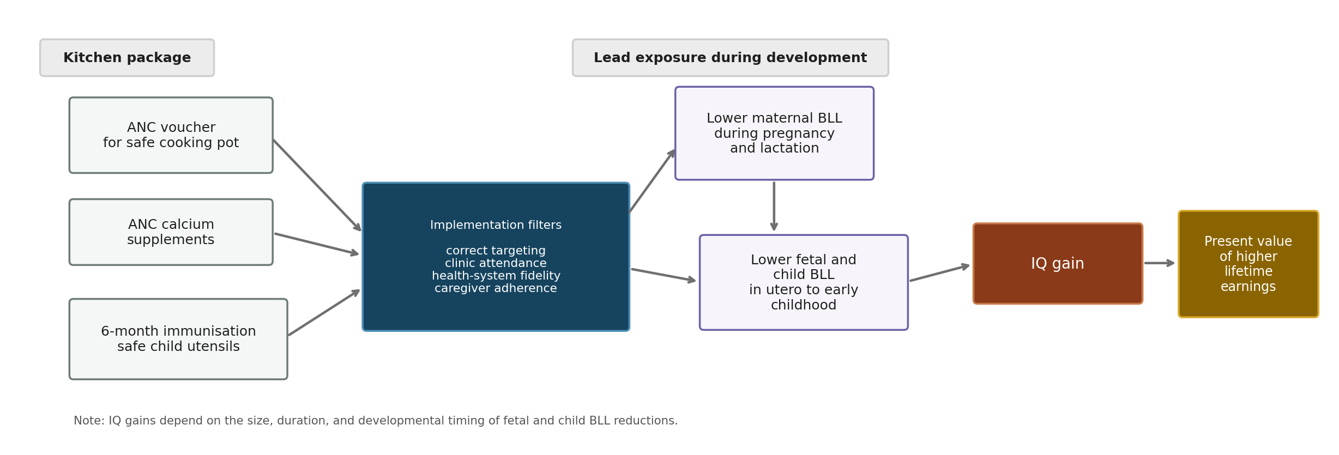
Pathway For The Kitchen Package
Kitchen package cognition pathway

Slide 11
Economic Model
Unit: mother-child pair in a targeted high-risk setting.
Costs: product costs, counselling, distribution, programme overhead and fixed screening cost per birth.
Benefits: child IQ gains mapped to lifetime earnings; maternal/neonatal and adult CVD benefits are secondary extensions.
Main output: benefit-cost ratio.

Slide 12
Earnings Channel
Present value of lifetime earnings:
productivity = GDP PPP per capita x labour force participation
year-by-year survival from birth to adulthood and through working life
real growth and social discounting
Lead channel:
lower BLL -> IQ gain -> higher lifetime earnings

Slide 13
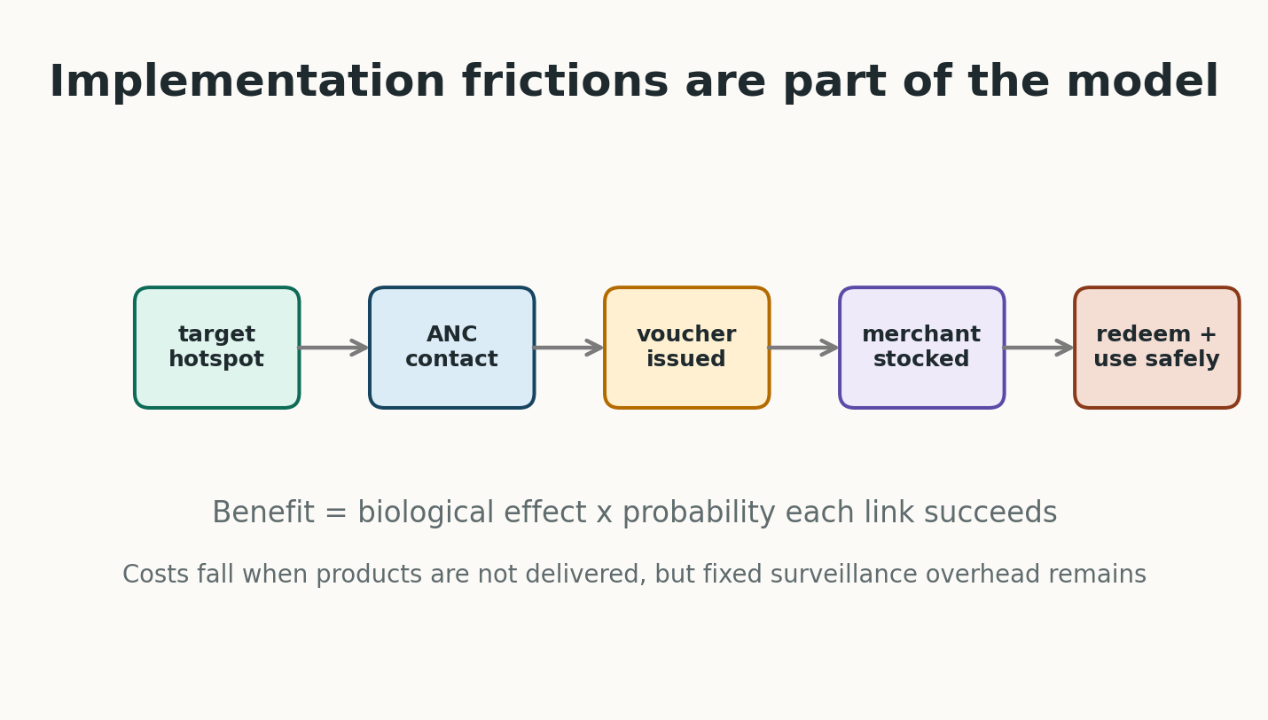
Why The Model Is Conservative In Spirit
Voucher implementation chain

Slide 14
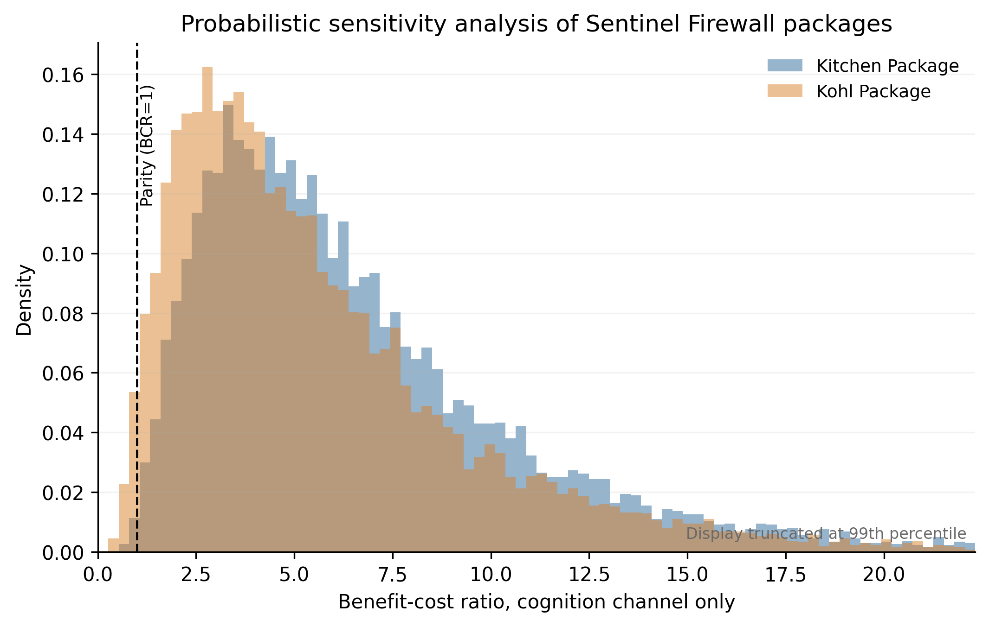
Main Results
BCR distributions

Slide 15
Result Magnitudes
Kitchen Package cognition BCR: median 5.58
5th-95th percentile range 1.97 to 15.20
0.28% of simulations below parity
Kohl Package cognition BCR: median 4.66
5th-95th percentile range 1.42 to 14.00
1.69% below parity

Slide 16
Interpretation For Economists
These are not universal LMIC estimates.
They are a demonstration using plausible LMIC values in settings where the hazardous product is common.
The high returns come from a large human-capital externality relative to low costs of substitute products
Even assuming many gaps in implementation
The uncertainty is real, but much of it is measurable in pilots.

Slide 17
What Drives The Results?
Product-specific BLL reduction: does the product really matter locally?
Prevalence: are we targeting a true hotspot?
Implementation: does the health system deliver and do households use the safe good (& quit using unsafe)?
BLL-to-IQ and IQ-to-earnings parameters
Discounting and local productivity

Slide 18
Local Adaptation Tool
The Python model runs the full probabilistic sensitivity analysis.
The Excel/Google Sheets version is a deterministic mode-only tool.
Local users can change:
product prevalence
product prices
attendance and fidelity
redemption and use
expected BLL response
productivity and discounting

Slide 19
What A Pilot Should Measure
Baseline product contamination and household use
Voucher issuance and redemption
Merchant stock and prices
Sustained use by pregnant women and young children
Residual use of unsafe products
Measured child or maternal BLL response

Slide 20
Contribution
Reframes lead control as a targeted human-capital investment.
Connects environmental health, maternal-child health platforms and benefit-cost analysis.
Makes assumptions transparent enough to challenge.
Provides code and spreadsheet tools so local teams can decide whether substitution is attractive in their own setting.

Slide 21
Selected References
Lanphear et al. 2005; Canfield et al. 2003; Jusko et al. 2008 on lead and cognition.
Crawfurd et al. 2025 on lead and learning in developing countries.
Ozawa et al. 2022; Grosse et al. 2002; Hanushek and Woessmann 2008 on cognition and earnings.
Weidenhamer et al. 2014, 2023 and Sargsyan et al. 2024 on contaminated products.
Larsen and Sanchez-Triana 2023 on global lead burden and costs.

Slide 22
Discussion
Where would substitution be most attractive?
What parameter would you most want to identify causally?
Should the first pilot randomise vouchers, prices or information?
How should we value cognition gains in largely informal labour markets?

Slide 23
Family was using an unsafe pot
Attend ANC
Health center has voucher for pot and gives intervention
Caregiver finds store with pot in stock & redeems voucher
Mother uses the new pot and not the old when pregnant and nursing and for toddler
Lower maternal BLL during pregnancy & lactation
Lower fetal BLL, infant BLL when nursing & toddler BLL once complementary feeding begins
Improved neurodevelopment, higher IQ, fewer behavioral problems
Higher productivity and earning

Slide 24
Family was using an unsafe pot
Attend ANC
Health center has voucher for pot and gives intervention
Caregiver finds store with pot in stock
Caregiver redeems voucher

